Slide 1

Analysis of Derm AI Diagnostics Skin Cancer Dataset
BFMT Data Hub

Slide 2

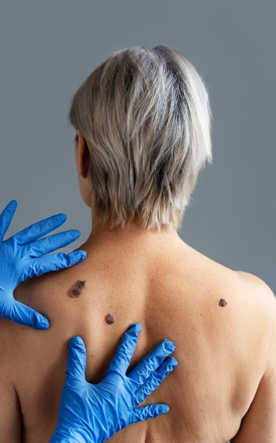
SQL Capstone Project
Analysis Of DermAi Diagnostics Skin Cancer Dataset
Group MEMBERS
Abimbola Orekoya
Fanta Conta
Elo Merit
Babajide Adesanya

Slide 3


Business Overview – DermAI Diagnostics
DermAI Diagnostics is a pioneering health-tech company committed to transforming early skin cancer detection. By integrating machine learning with clinical dermatology research,
DermAI aims to provide data-driven insights that empower medical professionals in diagnosing and treating skin lesions more accurately and efficiently.
Our Focus:
AI-powered diagnostic tools: Leveraging artificial intelligence to analyze skin lesion characteristics and predict potential malignancies.
Clinical research enhancement: Supporting dermatological studies with structured, high-quality data to uncover patterns in patient health and lesion development.
Bridging dermatology with data: Connecting real-world clinical data with advanced analytics to improve early detection, reduce misdiagnosis, and support evidence-based decisions.

Slide 4
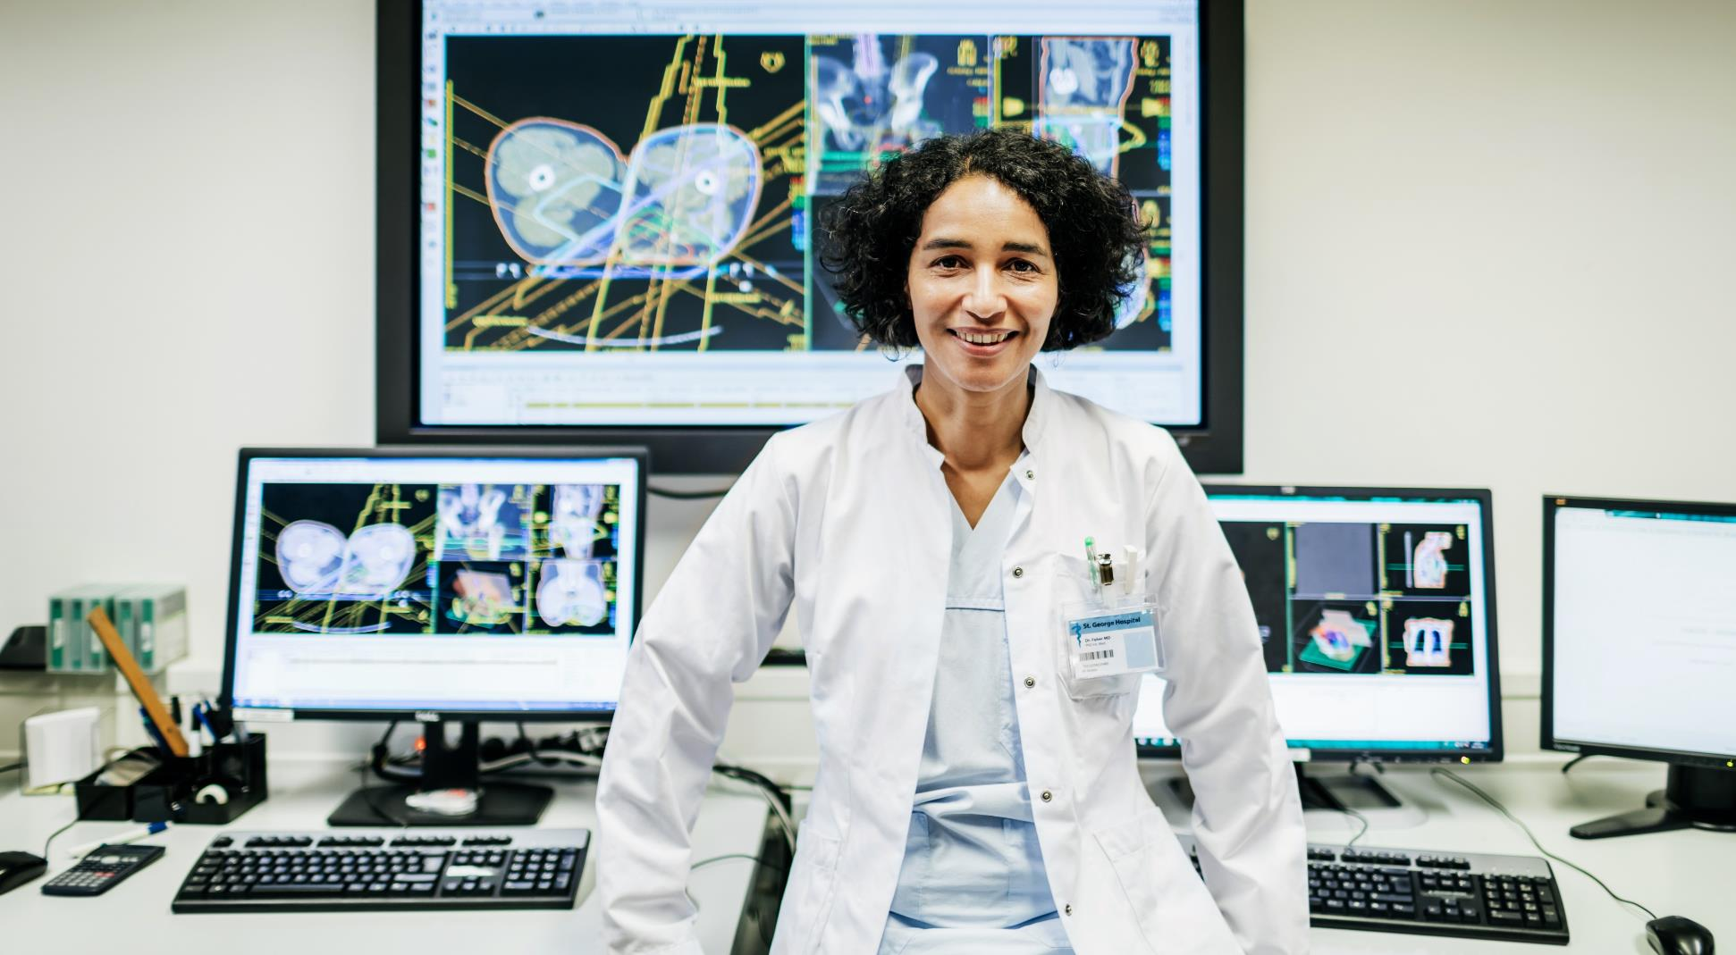

THE PROBLEM WE ARE SOLVING
Late Detection of Skin Cancer
Misdiagnosis & Environmental Factors Overlooked
Lack of Structured, Queryable Datasets
Skin cancer is often diagnosed at a late stage, reducing treatment effectiveness.
Limited access to dermatologists leads to high rates of misdiagnosis.
Medical data is often unstructured, making analysis difficult.
Early detection dramatically increases survival rates but remains challenging.
Key risk factors like sun exposure, pesticide contact, and family history are underutilized in diagnosis.
There's a critical need for datasets that support SQL-based queries to uncover hidden patterns and support clinical decision-making.

Slide 5
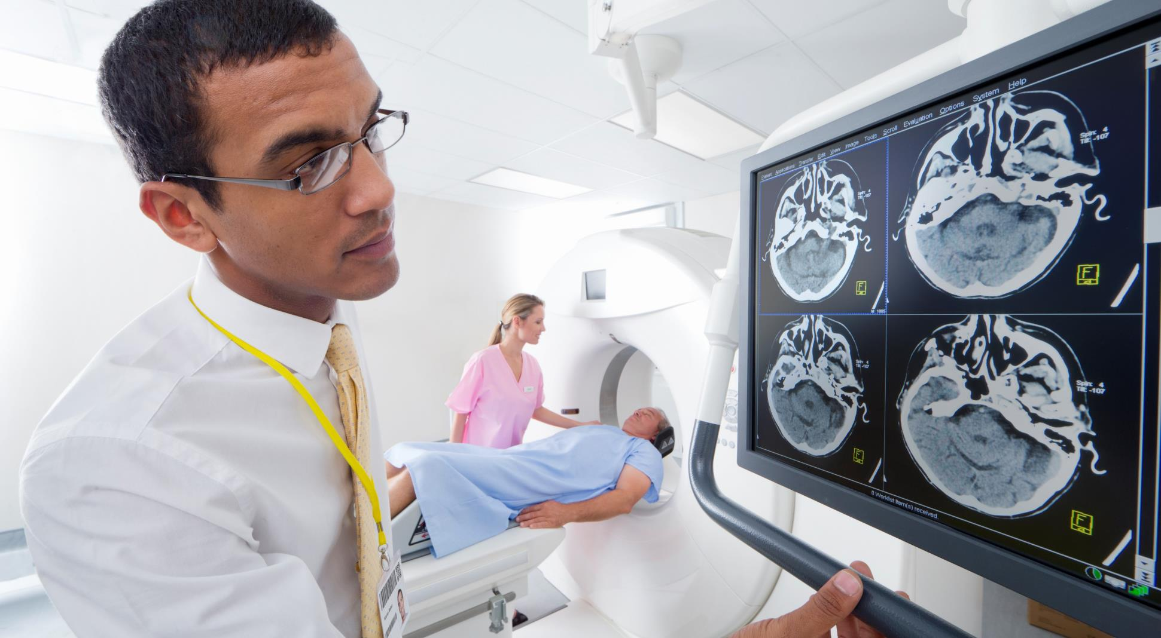




Project Rationale
Bridging Data and Medicine
Early Detection & Prevention
AI-Driven Medical Research
Real-World Application
SQL Learning Opportunity
END GOAL

Slide 6


Project Objectives & Methodology
Clear Objectives
Methodology
Join clinical + lesion data via SQL
Identify risk factors using queries
Analyze patterns in lesion characteristics
Structure data for machine learning
Import Dataset
Join Tables
Write Queries
Analyze Results
Provide Recommendations

Slide 7
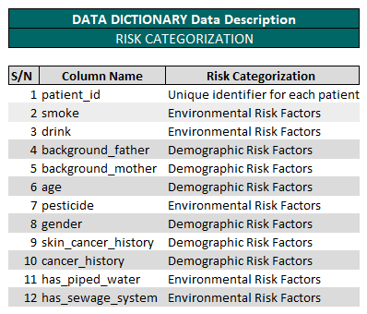
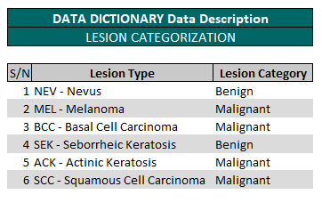
THE Data Description MARKET
Dataset Overview – Risks Categorization and Lesion Categorization

Slide 8
SQL Queries & Insights
Find correlation between variables and lesion type
Analyze lesion characteristics (e.g., itching, growth) with diagnoses
Environmental risk analysis (pesticide, smoke)

Slide 9
Examining lesion traits to identify underlying patterns
MULTIPLE VARIABLE SEGMENTATION
97%
95%
98%
71%
81%
SMOKE
DRINK
PESTICIDE
MALE
FEMALE
VARIABLES | MALIGNANT | BENIGN | % MALIGNANT | REMARKS
Smoke | 60 | 2 | 97 | High Risk Factor
Drink | 131 | 7 | 95 | High Risk Factor
Pesticide | 218 | 5 | 98 | High Risk Factor
Male Gender | 515 | 211 | 71 | High Risk Factor
Female Gender | 292 | 70 | 81 | High Risk Factor

Slide 10
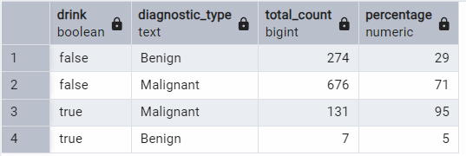
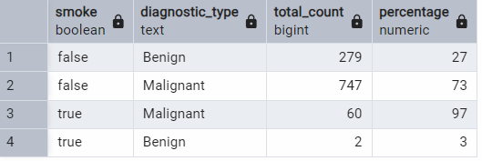
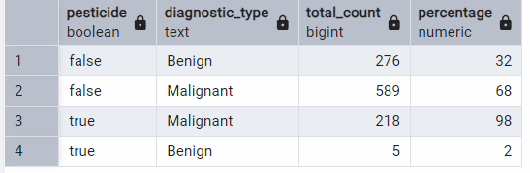
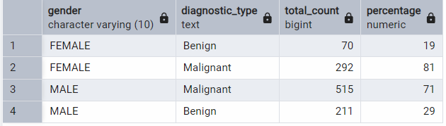
HOW DOES THE DEMOGRAPHIC FACTORS AFFECT THE LESION TYPE?

Slide 11
Examining lesion traits to identify underlying patterns
AGE SEGMENTATION
0%
33%
79%
83%
84%
0-19
20-29
40-59
60-79
80+
VARIABLES | MALIGNANT | BENIGN | % MALIGNANT | REMARKS
0-19 | 0 | 20 | 0 | Low Risk Factor
20-39 | 41 | 85 | 33 | Low Risk Factor
40-59 | 306 | 82 | 79 | High Risk Factor
60-79 | 381 | 79 | 83 | High Risk Factor
80+ | 79 | 15 | 84 | High Risk Factor

Slide 12
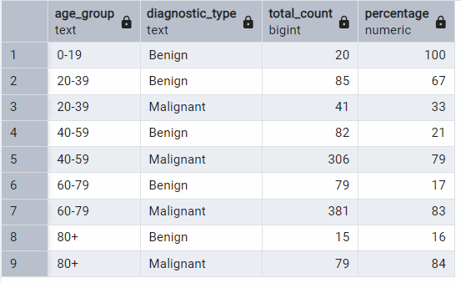
HOW DOES AGE DISTRIBUTION AFFECTS LESION TYPES?

Slide 13
Examining lesion traits to identify underlying patterns
REGION SEGMENTATION
The top 5 body regions were analyzed and the table reveals region that have an higher risk factor of getting a skin legion

Slide 14
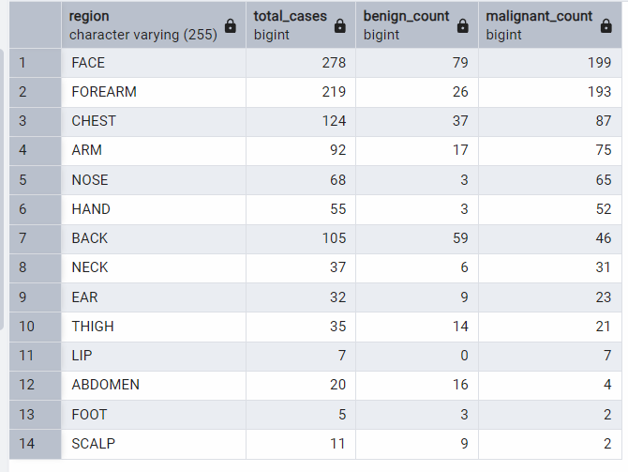
How does region affect the lesion diagnostic type

Slide 15
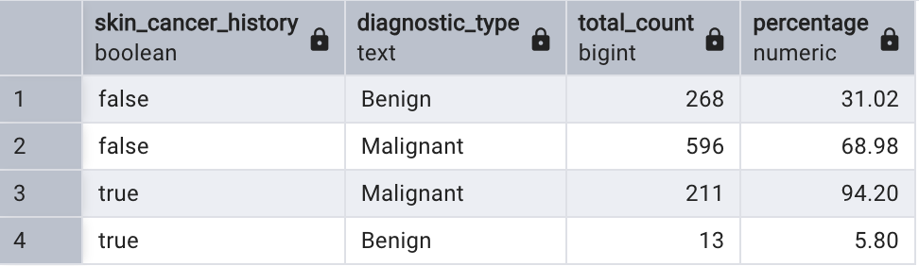
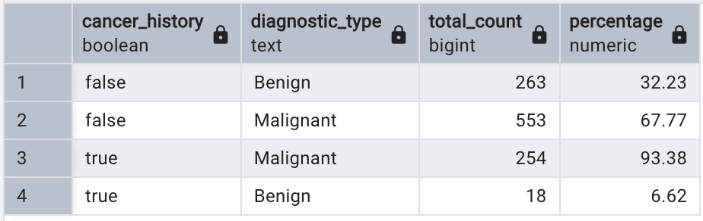
How does cancer history affect lesion diagnostic type?

Slide 16
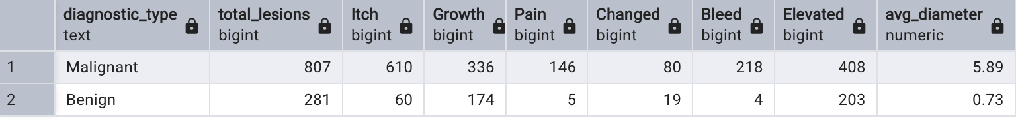
Distribution of the lesion characteristics

Slide 17

Advancing Skin Health Research with Organized Clinical Datasets
Key Insights & Recommendations
Age is a major risk factor. Malignancy increases with age as older patients had more proportion of malignant lesions. People in their mid-twenties should be encouraged to go for screening if there are other noticeable and concerning symptoms to encourage early detection. Aged-based screening intensity should be done with priority given to older people.
Even though smokers and drinkers are minority, they show alarmingly high malignancy rates with 95% drinkers and 97% smokers having malignant lesions while a combination of patients who drink and smoke have a 100% malignancy rate.
Malignant lesions have larger lesions (considering an average diameter of 5,89mm) Patients with large lesions should be prioritized for screening as a large lesion diameter might indicate cancerous lesions.
Patients with history of general cancer have a 93% chance of developing malignant lesions. Patients with skin cancer history have 94% malignancy. A combination of both have malignancy of 95.08%. This shows a strong correlation, and both factors should be considered as strong predictors of malignancy.

Slide 18

Thank you

